Slide 1

Columnstore Indexes in SQL Server 2014
Flipping the DW /faster Bit:
A Fast-Paced Introduction to an Exciting Feature
Jimmy May, MCM
jimmy.may@sandisk.com
@aspiringgeek
SQL Server Solutions Architect

Slide 2
Forward-Looking Statements
During our meeting today we will make forward-looking statements.
Any statement that refers to expectations, projections or other characterizations of future events or circumstances is a forward-looking statement, including those relating to products and their anticipated availability, capacities, pricing, capabilities, performance and compatibility, and benefits to customers.
Actual results may differ materially from those expressed in these forward-looking statements due to a number of risks and uncertainties, including the factors detailed under the caption “Risk Factors” and elsewhere in the documents we file from time to time with the SEC, including our annual and quarterly reports.
We undertake no obligation to update these forward-looking statements, which speak only as of the date hereof.

Slide 3








Bio
Jimmy May, MCM
SanDisk SQL Server Solutions Architect
Formerly:
Sr. Program Manager, SQL CAT
SQL Server Customer Advisory Team
MSIT Principal Architect: Database
Microsoft Certified Master: SQL Server (2009)
MS IT Gold Star Recipient (2008)
Microsoft Oracle Center of Excellence (2008)
SQL Server MVP Nominee (2006)
Indiana Windows User Group www.iwug.net
Founder & Board of Directors
Indianapolis Professional Association for SQL Server www.indypass.org
Founder & Member of Executive Committee
SQL Server Pros: Founder & Visionary-in-Chief
SQL Innovator Award Recipient (2006)
Contest sponsored in part by Microsoft
Formerly Chief Database Architect for high-throughput OLTP VLDB at ExactTarget (recent IPO)
Senior Database Administrator for OpenGlobe/Escient
www.twitter.com/aspiringgeek jimmy.may@sandisk.com jimmymay@outlook.com
http://sqlblog.com/blogs/jimmy_may

Slide 4

Data Propulsion Laboratory — DPL

Slide 5
C:\>sqlservr.exe /faster
Notes:
Those of you who know me are aware of my passion for performance—flipping the faster bit!

Slide 6
Agenda
Introduction & Preamble
SQL Server 2012 & 2014: New! Improved! Features
Columnstore Indexes
Overview
Architecture
SQL Server 2012 vs. 2014
Implementation
Scenarios
Best Practices
More Info

Slide 7
Session Objectives And Takeaway
Session Objectives
Understand that columnstore indexes can increase SQL Server DW query performance by one, two, or three orders of magnitude.
Understand the advantages & limitations of columnstore indexes in SQL Server 2012 & the significant improvements available in SQL Server 2014.
Key Takeaway
Understand the circumstances under which columnstore indexes may be a compelling reason to upgrade to SQL Server 2014 and start experimenting today.

Slide 8

Acknowledgements
Shahry Hashemi, Wingman, CapitalOne
Thomas Kejser, Fusion-io CTO (former SQL CAT PM)
Mike Ruthruff, Bungie Studios (former SQL CAT PM)
Justin Lane, Principal PM
Susan Price, SQL Server PM (former)
Eric Hansen, SQL Server PM
Gus Apostol, SQL Server PM
Gavin Payne, MCA, COEO Consultant
Steve Fisher, MSIT Senior Service Engineer
LeRoy Tuttle, Sr. SDE
Chris Adkin
Mahesh Jambunathan, SDE
Hrair Kerametlian, Principal PM
Emanuel Rivera Aleman (EMAN), Sr. SE
Bill Kan, Sr. SE
Igor Stanko, Principal PM
Srikumar Rangarajan, Principal Dev Lead
Stanislav Novoseletskiy, Principal Platform Specialist

Slide 9
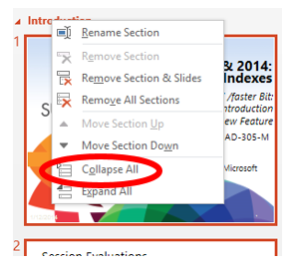
Navigating this deck
You may find the deck easier to navigate by collapsing the Sections:
Right-click on any section name
Click “Collapse All”)
Review the section names for desired content

Slide 10
Agenda
Introduction & Preamble
SQL Server 2012 & 2014: New! Improved! Features
Columnstore Indexes
Overview
Architecture
SQL Server 2012 vs. 2014
Implementation
Scenarios
Best Practices
More Info

Slide 11
SQL Server 2012 Noteworthy Features
AlwaysOn
AlwaysOn Availability Groups
Several other features: http://msdn.microsoft.com/en-us/library/cc645581%28v=SQL.110%29.aspx
Indirect Checkpoints
Smooth out I/O spikes from checkpoints
Contained Databases
Server-level metadata stored in the database (e.g., users)
Support for 15,000 partitions
1/hour > 625 days
1/day > 40 years
1/month > 1,250 years
Columnstore Indexes
More in a moment…
SQL Server 2012 What’s New
Whitepaper http://download.microsoft.com/download/E/9/D/E9DBB1BB-89AE-4C70-AF02-AAFC29451A85/SQL_Server_2012_Whats_New_White_Paper.pdf
MSDN (including SQL Server 2012 SP1) http://msdn.microsoft.com/en-us/library/bb500435.aspx
Notes:
This is *not* a marketeering session, but I want to cite a few of my favorite features.
You’re probably aware of these—but give me a couple of minutes…
AlwaysOn: The SQL 2012 marquis feature.
Indirect Checkpoints: Great demo from Joe Sack
Setting indirect checkpoints by database in SQL Server 2012
http://www.sqlskills.com/blogs/joe/setting-indirect-checkpoints-by-database-in-sql-server-2012/

Slide 12
SQL Server 2014 New Features
Hekaton: In-Memory OLTP
It’s reputation precedes it
AlwaysOn AG Enhancements
8 secondaries (including Azure secondaries)
Support for Windows Server Clustered Shared Volumes (CSVs)
Readable secondaries now stay online even with network or quorum loss
Online Database Ops
Single partition online rebuild!
Partition switching far more compatible with true online ops
BI: PowerView, PowerQuery, etc.
Unannounced
Partition-level Statistics
Cardinality Estimator updated
Buffer Pool Extensions
SELECT * INTO parallelism
Columnstore Indexes: Updatable, Smarter, Faster
More in a moment…
Notes:
This is *not* a marketeering session, but I want to cite a few of my favorite features.

Slide 13
Agenda
Introduction & Preamble
SQL Server 2012 & 2014: New! Improved! Features
Columnstore Indexes
Overview
Architecture
SQL Server 2012 vs. 2014
Implementation
Scenarios
Best Practices
More Info

Slide 14
Demo: Columnstore vs. Conventional Index Performance
Notes:
If we’re looking for a subset of columns from one or a few rows, given the right indexes, SQL Server can do a superlative job of providing an answer.
If we’re asking a question which by design needs to hit lots of rows—reporting, aggregations, grouping, scans, etc., SQL Server has never had a good mechanism
—until columnstore.

Slide 15
What is a SQL Columnstore Index?
Codename Apollo
Part of SQL Server in-memory family of technologies
Common code path with VertiPaq
PowerPivot, PowerView, SSAS
Contrasted with traditional row stores in which data is physically stored row-by-row
Columnstore stores values for all rows for a given column
Notes:
Formerly known as “xVelocity” family of technologies
In other words:
A given data page will store values ONLY for the given column to which that page is allocated.
Storage is pivoted relative to the row stores we’ve all grown up with.
Columnstore literally turns row storage on its head
—& this isn’t the only thing that’s different...

Slide 16


Row Store vs. Columnstore: A Metaphor
If only we were live & in-person...
SQL Server 2014 Launch Event on May 31, 2014 #SQLSaturday306
Images starring #SQLWingman @dsfnet & @aspiringgeek courtesy Tom Roush @GEEQL
Tweet: https://twitter.com/GEEQL/status/472861392039473153
Notes:
In this example, let’s pretend that Shahry is a row on a data page:
Let’s use our imagination. Shahry’s head corresponds to a value in the first column, his chest to a value in the second, his abdomen, thighs, etc. correspond to values in other columns. The data page is storing heterogenous values with all the concomitant benefits—& disadvantages of a row store.
Whereas my handstand here corresponds to a given columnstore data page which is storing values ONLY for the given column to which that page is allocated.
Now hopefully you understand what I meant when I said that columnstore literally turns row storage on its head.

Slide 17
Columnstore High-Level Characteristics
Highly compressed
Aggressive readahead
In-memory/disk hybrid structures
Processes data in units called "batches“
Vector-based query execution
Query Optimizer automatically considers columnstore indexes during compilation
Numerous deep engine modifications
I/O, Memory, & Caching
Notes:
Compression: Typically exceeds the level of page compression—because columnar data tends to be more homogenous
Aggressive readahead: Shares characteristics with the engine’s mechanisms
In-memory: NOT a requirement! (unlike, e.g., In-Memory OLTP (formerly known as Hekaton));
by design, columnstore is a hybrid structure, leveraging both disk & memory, depending on available resources
Batches: Designed to work best with 1,000 rows at a time
vs. Row mode (a failback mechanism, not nearly as efficient)
Vector-based batch processing: Maps data to pointers that are manipulated in the proc’s L1 cache—& it doesn’t get much better than that!
Transparency: Automagic!
Engine Integration: Columnstore wasn’t bolted on—it’s deeply integrated into the engine.

Slide 18
Why Use Columnstore Indexes?
Designed to optimize access to large DWs (vs. OLTP)
Star schema, large fact tables (esp. integer keys), aggregations, scans, reporting
Faster, interactive query response time
Transparent to the application
Most things “just work”
Backup and restore
Mirroring, log shipping
SSMS, etc.
There are some gotchas (stay tuned…)
Notes:
[As we may have discussed earlier:]
If we’re looking for a subset of columns from one or a few rows, given the right indexes, SQL Server can do a superlative job of providing an answer.
If we’re asking a question which by design needs to hit lots of rows—reporting, aggregations, grouping, scans, etc., SQL Server has never had a good mechanism
—until columnstore.

Slide 19
Why Use Columnstore? (cont.)
Reduced physical DB design effort
Fewer (or no!) conventional indexes
Reduced need for summary aggregates and indexed views
May eliminate need for OLAP cubes
Lower TCO
Yes, I had to say this!
Notes:
Consider the case in which a report query on your DW has gone rogue. Your former indexing strategery, in place for months or years, worked great. Then suddenly, instantaneously, historical response times increased dramatically. The usual quick fixes, e.g., updating stats, don’t work. Your flagship app has slowed to a crawl. Managers are looking over your shoulder, even breathing down your neck; you realize you’re practicing in front of the CFO. A war room is called. Hours or days are spent balancing competing interests such as column key order, the number of indexes, how wide they are, the queries they cover, etc...
...Imagine a world where it didn’t have to happen that way. A world in which no index tuning was required. Where one index worked for each-&-every query. Welcome to the world of columnstore.

Slide 20
Agenda
Introduction & Preamble
SQL Server 2012 & 2014: New! Improved! Features
Columnstore Indexes
Overview
Architecture
SQL Server 2012 vs. 2014
Implementation
Scenarios
Best Practices
More Info

Slide 21
Star Schema
FactSales
FactSales ( CustomerKey int
, ProductKey int
, EmployeeKey int
, StoreKey int
, OrderDateKey int
, SalesAmount money
)
--note: lots of ints in fact tables
DimCustomer ( CustomerKey int
, FirstName nvarchar(50)
, LastName nvarchar(50)
, Birthdate date
, EmailAddress nvarchar(50)
)
DimProduct (…
Best Practice: Integer keys!
DimDate
DimEmployee
DimCustomer
DimStore
Notes:
Brief review
Dims: metadata describing the Facts
Best practice: Integer keys!
Joins on character data may compromise the Optimizer’s ability to leverage columnstore batch processing
Result: Possible failover from batch mode to row mode

Slide 22
How Do Columnstore Indexes Optimize Perf?
Heaps, B-trees store data row-wise
…
C1
C2
C3
C4
Columnstore indexes store data column-wise
Each page stores data from a single column
Highly compressed
About 2x better than PAGE compression
More data fits in memory
Each column accessed independently
Fetch only needed columns
Can dramatically decrease I/O
Notes:
Heaps, B-trees store data row-wise
Columnstore indexes store data column-wise
Each page stores data from a single column
Highly compressed
About 2x better than PAGE compression
More data fits in memory
Each column accessed independently
Fetch only needed columns
Can dramatically decrease I/O

Slide 23
Columnstore Index Architecture
Segment
Row Group
1 million logically contiguous rows
Column Segment
Segment contains values from one column for a set of rows
Segments for the same set of rows comprise a row group
Segments are compressed
Each segment stored in a separate LOB
Segment is unit of transfer between disk and memory
C1
C2
C3
C4
C5
C6
Row Group
Notes:
Heaps, B-trees store data row-wise
Do not over-complicate this—fundamentally it’s as easy as it looks

Slide 24
Columnstore Index Example
OrderDateKey | ProductKey | StoreKey | RegionKey | Quantity | SalesAmount
20101107 | 106 | 01 | 1 | 6 | 30.00
20101107 | 103 | 04 | 2 | 1 | 17.00
20101107 | 109 | 04 | 2 | 2 | 20.00
20101107 | 103 | 03 | 2 | 1 | 17.00
20101107 | 106 | 05 | 3 | 4 | 20.00
20101108 | 106 | 02 | 1 | 5 | 25.00
20101108 | 102 | 02 | 1 | 1 | 14.00
20101108 | 106 | 03 | 2 | 5 | 25.00
20101108 | 109 | 01 | 1 | 1 | 10.00
20101109 | 106 | 04 | 2 | 4 | 20.00
20101109 | 106 | 04 | 2 | 5 | 25.00
20101109 | 103 | 01 | 1 | 1 | 17.00
Notes:
Let’s pretend we’re looking at a few hundred million rows...
Pay attention—there’ll be a quiz

Slide 25
1. Horizontally Partition (Row Groups)
OrderDateKey | ProductKey | StoreKey | RegionKey | Quantity | SalesAmount
20101107 | 106 | 01 | 1 | 6 | 30.00
20101107 | 103 | 04 | 2 | 1 | 17.00
20101107 | 109 | 04 | 2 | 2 | 20.00
20101107 | 103 | 03 | 2 | 1 | 17.00
20101107 | 106 | 05 | 3 | 4 | 20.00
20101108 | 106 | 02 | 1 | 5 | 25.00
OrderDateKey | ProductKey | StoreKey | RegionKey | Quantity | SalesAmount
20101108 | 102 | 02 | 1 | 1 | 14.00
20101108 | 106 | 03 | 2 | 5 | 25.00
20101108 | 109 | 01 | 1 | 1 | 10.00
20101109 | 106 | 04 | 2 | 4 | 20.00
20101109 | 106 | 04 | 2 | 5 | 25.00
20101109 | 103 | 01 | 1 | 1 | 17.00

Slide 26
2. Vertically Partition via Columns (Segments)
OrderDateKey
20101107
20101107
20101107
20101107
20101107
20101108
ProductKey
106
103
109
103
106
106
StoreKey
01
04
04
03
05
02
RegionKey
1
2
2
2
3
1
Quantity
6
1
2
1
4
5
SalesAmount
30.00
17.00
20.00
17.00
20.00
25.00
OrderDateKey
20101108
20101108
20101108
20101109
20101109
20101109
ProductKey
102
106
109
106
106
103
StoreKey
02
03
01
04
04
01
RegionKey
1
2
1
2
2
1
Quantity
1
5
1
4
5
1
SalesAmount
14.00
25.00
10.00
20.00
25.00
17.00

Slide 27
3. Compress Each Segment*
OrderDateKey
20101107
20101108
ProductKey
106
103
109
StoreKey
01
04
03
05
02
RegionKey
1
2
Quantity
6
1
2
4
5
SalesAmount
30.00
17.00
20.00
25.00
OrderDateKey
20101108
20101109
ProductKey
102
106
109
103
StoreKey
02
03
01
04
RegionKey
1
2
Quantity
1
5
4
SalesAmount
14.00
25.00
10.00
20.00
25.00
17.00
Some segments will compress more than others
*Encoding and reordering not shown
Notes:
Summary: Three fundamental steps occur *under the covers* during Columnstore Index creation (this is transparent to the user):
Horizontal partitioning into Row Groups (1M rows each)
Vertical partitioning into Segments (constituent columns)
Compression (aggressive—because columnar data tends to be homogenous)

Slide 28
Fetch only needed columns
SELECT ProductKey, SUM (SalesAmount)
FROM SalesTable
WHERE OrderDateKey < 20101108
GROUP BY ProductKey
StoreKey
01
04
03
05
02
RegionKey
1
2
3
Quantity
6
1
2
4
5
OrderDateKey
20101107
20101108
ProductKey
106
103
109
SalesAmount
30.00
17.00
20.00
25.00
StoreKey
02
03
01
04
RegionKey
1
2
Quantity
1
5
4
OrderDateKey
20101108
20101109
ProductKey
102
106
109
103
SalesAmount
14.00
25.00
10.00
20.00
25.00
17.00
Notes:
Depending on query, the Optimizer performs Row Group (or Partition) & Segment elimination

Slide 29
Agenda
Introduction & Preamble
SQL Server 2012 & 2014: New! Improved! Features
Columnstore Indexes
Overview
Architecture
SQL Server 2012 vs. 2014
Implementation
Scenarios
Best Practices
More Info

Slide 30
Columnstore with Performance Workarounds
Not directly compatible with:
Indexed views
Filtered indexes
Sparse columns
Computed columns (non-persisted or persisted)
However, be mindful that these are workarounds for performance & are largely rendered moot by columnstore performance

Slide 31
SQL Server 2012 Caveats
Non-clustered columnstore—underlying B-tree still required to support the columnstore
Some queries, even the schema, might have to be modified to fully leverage columnstore
Read only, not writable
In SQL 2012
Work-around: “Trickle-loading” (described later)
Memory Required to create columnstore indexes may exceed that for conventional indexes
Enterprise Edition only
Not yet available in Azure
Except IaaS
Datatype support significant but not complete
Notes:
Succinct Lists:
Supported SQL Server 2012: int, real, string, money, datetime, decimal <= 18 digits
Not supported SQL Server 2012: decimal > 18 digits, binary, varbinary, CLR, (n)varchar(max), varbinary (max), uniqueidentifier, datetimeoffset with precision > 2
Coming in SQL14: Everything except blobs: CLR, (n)varchar(max), varbinary(max), XML, Spatial
Data types not supported in 2012 (significantly expanded in SQL v.next):
binary and varbinary
ntext , text, and image
varchar(max) and nvarchar(max)
uniqueidentifier
rowversion (and timestamp)
sql_variant
decimal (and numeric) with precision greater than 18 digits
datetimeoffset with scale greater than 2
CLR types (hierarchyid and spatial types)
xml

Slide 32
SQL Server 2014 Query Optimization
Good design practices for dimensional models
Star schema
Columnstores on Fact tables
Integer surrogate keys for joins to Dimension tables
The power of the platform
You just write queries!
Logically no difference between Clustered Columnstores and conventional tables
Notes:
Resource utilization is minimized if neither base table nor nonclustering indexes need to be maintained
Logically there’s no difference between a conventional base table & a clustered columnstore

Slide 33
Columnstore in SQL 2014
Fully Read/Write
More transparency to the app than ever
No need for “trickle-loading” or other workarounds
...Yet Partition switching & BULK INSERT remain best practices
Data type support expanded:
All data types except: (n)varchar(max), varbinary(max), XML, Spatial, CLR
Basically, SQL14 columnstore is compatible with all non-blob datatypes

Slide 34
Columnstore in SQL Server 2014 (cont.)
New: Clustered Columnstore
Dependency on conventional b-tree structures has been removed
Potential for significant disk space savings if workload is satisfied without conventional indexes
Note: Non-clustered columnstore is still supported & is still a read-only structure
Required if:
Constraints are required
Workload requires b-tree non-clustered indexes

Slide 35
Columnstore in SQL Server 2014 (cont.)
“Batch mode”:
Query Processor vector-based (L1 cache resident) operations expanded, improved
New support for:
All joins (including OUTER, HASH, SEMI (NOT IN, IN)
UNION ALL
Scalar aggregates
“Mixed mode” plans
Improvements to bitmap, spill support, etc.
Hash join enhancements
Notes:
DW queries involve joins between a fact & dim tables.
Most DW joins use the dim PK - fact FK relationship
SQL Server has a special star join optimization of hash joins for DW queries
The Optimizer recognizes star join patterns & uses bitmap filtered hash joins
The Optimizer uses hash joins for non-sorted columns from both join tables
Hash joins can work in parallel threads
With bitmap filtering, they can work on a subset of rows from a dim + fact in each thread
Bitmap filtered hash joins outperform other types of joins for parallel queries with large scans
These are typical for DW environments
For hash joins, it is unecessary to index the FKs of a fact table

Slide 36
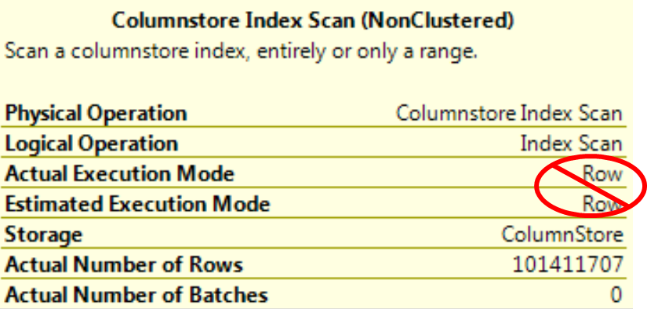
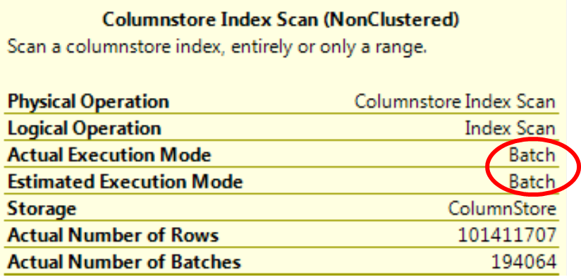
Batch Mode Processing
SQL Server 2012
Several engine limitations that can cause queries to run in row mode instead of batch mode
SQL Server 2014
Support for all flavors of JOINs
OUTER JOIN
Semi-join: IN, NOT IN
UNION ALL
Scalar aggregates
Mixed mode plans
Improvements in bitmaps, spill support, …
These enhancements are more important than read/write capabilities

Slide 37
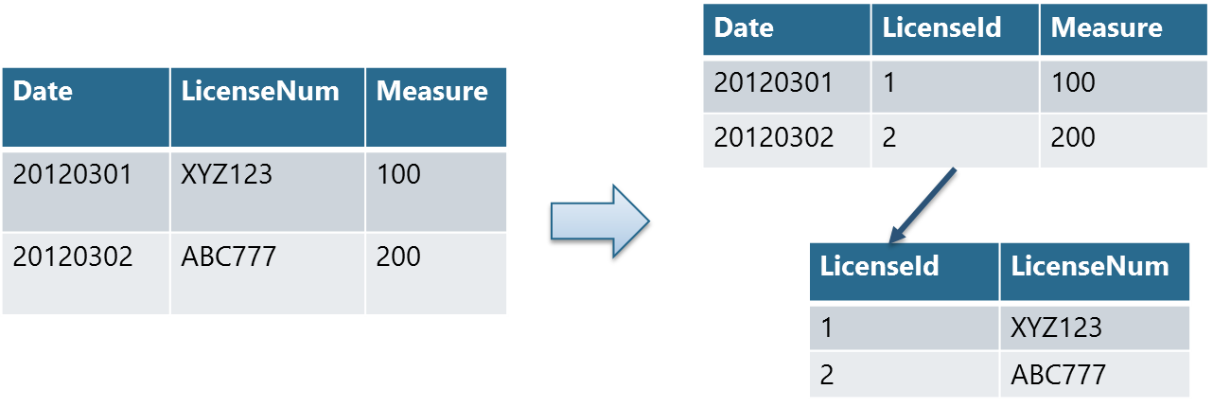
Factor Strings from Columnstore Joins
Columnstore joins on string columns is better in 2014 than 2012, yet still slower!
Factor strings from Fact out to Dim tables
Integer FKs is a DW best practice
See “Star Join” slide earlier
Demo later

Slide 38
Comparing Space Savings
Notes:
Depending on your indexing strategery, 5x – 10x space savings.
See also Linchi Shi:
SQL Server 2008 Page Compression: Compression ratios with real-world databases
http://sqlblog.com/blogs/linchi_shea/archive/2008/05/11/sql-server-2008-page-compression-compression-ratios-from-real-world-databases.aspx
Summary: Page compression with real-world databases is 1.7x – 5.6x (this does not include columnstore)

Slide 39
Archival Compression
Adds an additional layer of compression on top of the inherent compression used by ColumnStore
Shrink on-disk database sizes by up to 27%
Compression applies per partition and can be set either during index creation or during rebuild

Slide 40
Agenda
Introduction & Preamble
SQL Server 2012 & 2014: New! Improved! Features
Columnstore Indexes
Overview
Architecture
SQL Server 2012 vs. 2014
Implementation
Scenarios
Best Practices
More Info

Slide 41
Scenarios
Customer: Motricity: Case Study
MSIT SONAR App: Aggregations
booyah!
Customer: DevCon Security: Production App
double-booyah!
Windows Telemetry—Watson
triple-booyah!
MSIT Problem Management App
booyah^{nth}
Microsoft Fast Track
Notes:
Classic DW Query: Star Join & Aggregations Demo

Slide 42
SQL CAT Customer: Motricity
Sybase customer
Demographic data & app required columnstore capabilities
Proved out technology on Denali bits
Numerous learnings discovered & incorporated into SQL Server 2012 RTM
Production implementation leveraged partitioning & “trickle loading” (& AlwaysOn Availability Groups)
Case Study: http://www.microsoft.com/casestudies/Microsoft-SQL-Server-2012-Enterprise/Motricity/Mobile-Advertiser-Makes-Gains-with-Easy-Migration-of-Sybase-Database-to-Microsoft/710000000170
Customers: @armpitslinky, @SQLJackBurton, & the cuddliest customer ever in the SQL CAT Lab: @dsfnet

Slide 43
MSIT SONAR App PoC
 | Logical Reads (8K pages) | CPU (ms) | Durn (ms)
Columnstore | 160,323 | 20,360 | 9,786
Conventional Table & Indexes | 9,053,423 | 549,608 | 193,903
Δ | x56 | x27 | x20
Copyright © 2015 SanDisk. All rights reserved.

Slide 44
Customer: DevCon Security: Production App
Revenue History Fact Table
Table stats
22M rows
33GB data
137 columns
Indexing strategery challenging, especially for ad hoc queries

Slide 45
Customer: DevCon Security: Production App: SSRS
Scenario 1: SSRS
Before: SSAS cube processing + batch process ran MDX to dump results into a separate table
“…hassle to maintain”
Before: Queries against conventional table structures:
10 - 12 seconds
After: Queries against Columnstore:
1 second
One order of magnitude faster

Slide 46
Customer: DevCon Security: Production App: Ad Hoc Queries
Scenario 2: Ad Hoc Queries
Before: Queries took 5 – 7 minutes (300 – 420 seconds)
After: Columnstore: 1 – 2 seconds
Two orders of magnitude faster

Slide 47
Customer: DevCon Security: Production App: Outcomes
Unsolicited feedback:
“What we found was pretty awesome.”
“It has been a game changer for us in terms of the flexibility we can offer people that would like to get to the data in different ways.”
— Nathan Allphin, BI Team Lead
Customer is deprecating this aspect of their SSAS infrastructure in favor of columnstore

Slide 48
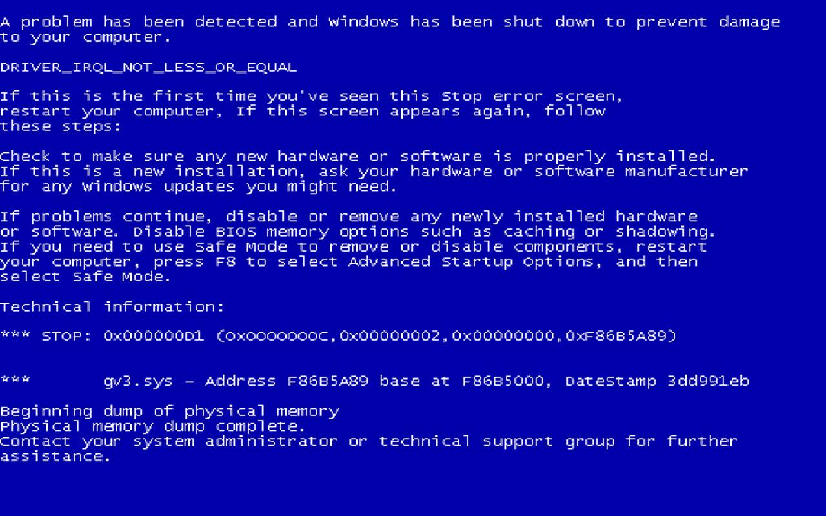

Slide 49
Windows Telemetry—Watson WER Failure Event Hit Counting: Aggregate record of all occurrences of user mode failures on Windows machines worldwide
Data: 61 billion rows, 6440 partitions, partitioned by date (12+ years), keyed on Day, iBucket, LCID, OEM, OS Version
ETL: SSIS flat files into staging HEAP table, indexes built to match target, perform SWITCH (+300M rows daily)
Formerly hours, now 5-minute queries! (50-100x gain)
Total hits by day, for all days
Filtered rollup on 3 dimensions
Features/Tricks/Lessons:
String values & SQLCLR UDT column located in dimension tables
Really bad perf hit if Foreign Keys are not trusted (is_not_trusted = 1)
Clustered index order can make huge difference in columnstore efficiency by grouping repeating values
MAXDOP configuration tradeoff; columnstore queries want it, other queries suck too much memory if MAXDOP is set too high
Lack of query partition elimination diminishes columnstore gains
Acknowledgements:
LeRoy Tuttle, Sr. SDE
Mahesh Jambunathan, SDE
Notes:
SQL Server 2012 All indexes aligned after BCP, before SWITCH Formerly, duration was infinite, i.e., The “Forever Total” queries would not run without column store; workaround was to use a loop to aggregate 1 day (partition) at a time, in a process taking several hours per day. The “LCD/OEM” query went from 30-60 minutes to less than 5.

Slide 50
MSIT Problem Management App
Interactive app for which queries returned results in unpredictable time frame: “2 – 7 minutes”
Wide table: 151 columns all commonly subject to interrogation
DB Dev troubleshooting time & expertise scarce
Indexing strategery difficult/impossible
Table stats
3.1M rows
15GB data (barely fits in memory; lots of churn)
1.7M data pages
Columnstore index: 478 pages (memory resident)
Notes:
8KB * 478 pages = 3,915,776 Bytes = ~4MB for columnstore index
vs. ~15GB for table scan

Slide 51
MSIT Problem Management
How to index a table with these columns?
TicketFolderID, ModuleName, ModuleSubType, TicketID, CreatedDate, CreatedByAlias, CreatedByFullName, CreatedByLocationCountry, CreatedByLocationCity, CreatedByLocationBuilding, Source, ContactType, ContactAlias, FirstName, LastName, Email, BusinessCustomer, ContactLocationCountry, ContactLocationCity, ContactLocationBuilding, ContactLocationAltCountry, ContactLocationAltCity, ContactLocationAltBuilding, AssetType, AssetService, ServiceCategory, AssetName, AssetModel, AssetModel1, AssetDescription, AssetManufacturer, AssetMake1, State, Status, Summary, Impact, Urgency, Priority, ContactReason, Details, Environment, EnvironmentSpecific, ScheduledDate, CurrentL1, CurrentL2, CurrentL3, CurrentGroupID, CurrentGroup, CurrentSubGroupID, CurrentSubGroup, CurrentTeamID, CurrentTeam, CurrentIndividual, AssignedToName, SLADeadline, ResolvedAtDate, ResponseDeadline, RespondedAtDate, AffectedService, RequestedService, ResolutionCategory, CloseDetails, FinalStatus, FailureImpact, ServiceOutage, CIOutage, KBArticleAction, KBArticleTitle, KBArticleID, ResolvedByAlias, ResolvedByFullName, ResolvedByLocationCountry, ResolvedByLocationCity, ResolvedByLocationBuilding, ResolvedByEmployeeType, ResolvedByCompany, MajorIncidentReviewDate, MajorIncidentReviewOutcome, AddlContacts, OnBehalfOf, OriginalPriority, OriginalServiceCategory, OriginalAssetType, OriginalAssetService, OriginalAssetName, OriginalAssetModel, OriginalAssetDescription, OriginalAssetManufacturer, OriginalContactReason, OriginalL1, OriginalL2, OriginalL3, OriginalGroupID, OriginalGroup, OriginalSubgroupID, OriginalSubgroup, OriginalTeamID, OriginalTeam, OriginalIndividual, AltTelephone, AltLocation, LocationType, TicketLocation, ReactivationReason, ClosedDate, EmailSentToQueueDate, FirstNonAutoResponseDate, FirstNonAutoResponseActType, FirstEscalationL1toL2Flag, FirstEscalationL1toL2Date, L2EscalationGroupID, L2EscalationGroup, L2EscalationSubgroupID, L2EscalationSubgroup, L2EscalationTeamID, L2EscalationTeam, L2FirstNonAutoResponseDate, L2FirstNonAutoResponseActivity, FirstEscalationL2toL3Flag, FirstEscalationL2toL3Date, L3EscalationGroupID, L3EscalationGroup, L3EscalationSubgroupID, L3EscalationSubgroup, L3EscalationTeamID, L3EscalationTeam, L3FirstNonAutoResponseDate, L3FirstNonAutoResponseActivity, ThirdPartyPendStatusDuration, ThirdPartyReference, LastUpdatedDate, PendingClosure, ThirdPartyName, ThirdPartyOther, SubGroupTransferFlag, SubGroupResponseDeadline, SubGroupResponseDate, PrimaryConfigFolderID, ServiceConfigFolderID, KBArticleDetails, ClusterNodes, ResolvableByPreviousTeam, ResolveComments, ClientPendingStatusDurationMin, PartsPendingStatusDurationMin, ContactJobTitle, KBArticleCategory, KBType, KBNotes, MetCommunication, AvgCommunicationTime

Slide 52
Typical Query
--CurrentGroup, CurrentSubGroup, ModuleName
SELECT TOP 10 CurrentGroup, CurrentSubGroup, KBArticleTitle, COUNT(*) as RowCnt
FROM dbo.ITSM01ISRM
WHERE CurrentGroup = 'ExD Services'
AND CreatedDate > dateadd(dd, -30, getdate())
AND CurrentSubGroup = 'SAP'
AND Status = 'Resolved'
GROUP BY CurrentGroup, CurrentSubGroup, ModuleName
ORDER BY COUNT(*) DESC
--OPTION (IGNORE_NONCLUSTERED_COLUMNSTORE_INDEX);

Slide 53
Query Duration used to be Unpredictable But Columnstore renders consistent subsecond results
Notes:
Execution duration of a single Problem Management query during business hours
SELECT TOP 10 CurrentGroup, CurrentSubGroup, ModuleName, COUNT(*) as RowCnt
FROM dbo.ITSM01ISRM
WHERE CurrentGroup = 'ExD Services'
AND CreatedDate > dateadd(dd, -30, getdate())
AND CurrentSubGroup = 'SAP'
AND Status = 'Resolved'
GROUP BY CurrentGroup, CurrentSubGroup, ModuleName
ORDER BY COUNT(*) DESC
—OPTION (IGNORE_NONCLUSTERED_COLUMNSTORE_INDEX);

Slide 54
Conventional vs. CS Perf: Duration

Slide 55
Conventional vs. CS Perf: Logarithmic

Slide 56
Conventional vs. CS Perf: I/O

Slide 57
Conventional vs. CS Perf: CPU

Slide 58
Row Store vs. Columnstore:
I/O vs. Query Throughput
Copyright © 2015 SanDisk. All rights reserved.

Slide 59
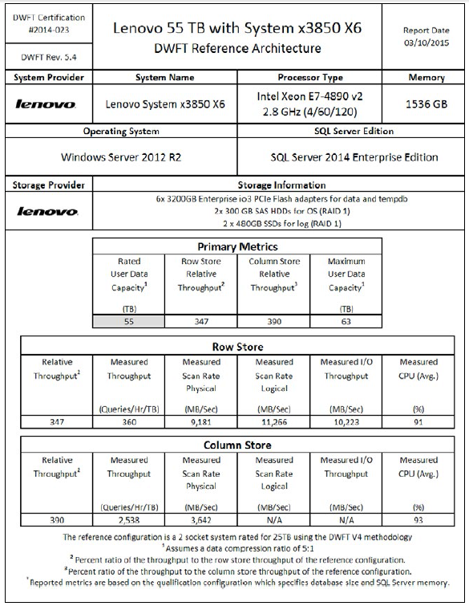

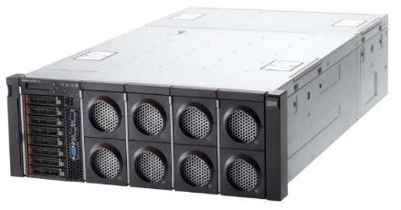
Lenovo 55TB Data Warehouse Fast Track Certification
Breakthrough Performance
- 11.3GB/s throughput
- 2548 queries / Hr / TB
- 98% average CPU utilization
NEW!
SanDisk-based 3200GB Lenovo io3 Flash Adapters
System x 3850 X6 Server
Copyright © 2015 SanDisk. All rights reserved.

Slide 60
Fast Track References
Microsoft Fast Track: Learn more http://www.microsoft.com/en-us/server-cloud/products/sql-server
Fast Track Data Warehouse Reference Guide for SQL Server 2012 https://msdn.microsoft.com/en-us/library/hh918452.aspx
Certified DWFTRA solutions for SQL Server (scroll down slightly) http://www.microsoft.com/en-us/server-cloud/data-warehouse-fast-track.aspx
Copyright © 2015 SanDisk. All rights reserved.

Slide 61
Columnstore Indexes: Room for Improvement…

Slide 62
Agenda
Introduction & Preamble
SQL Server 2012 & 2014: New! Improved! Features
Columnstore Indexes
Overview
Architecture
SQL Server 2012 vs. 2014
Implementation
Scenarios
Best Practices
More Info

Slide 63
Syntax Similar to Existing DDL
CREATE NONCLUSTERED COLUMNSTORE INDEX ix_cs_MyDWTable ON dbo.MyDWTable (col1 , col2 , ... , coln);
CREATE CLUSTERED COLUMNSTORE INDEX ix_cs_MyDWTable ON dbo.MyDWTable
--WITH (DROP_EXISTING = ON) ;
--no column list!
DROP INDEX dbo.MyDWTable.ix_cs_MyTable;
ALTER INDEX dbo.MyDWTable.ix_cs_MyTable DISABLE;
ALTER INDEX dbo.MyDWTable.ix_cs_MyTable ENABLE;
Notes:
SQL 2012: NONCLUSTERED only
SQL 2014: CLUSTERED or NONCLUSTERED (more later)

Slide 64
Hints to Force / Prevent Usage
Force the Optimizer to use:
…FROM dbo.MyDWTable
WITH (INDEX (ix_cs_MyTable))…
Prevent the Optimizer from using:
SELECT…
FROM dbo.MyDWTable
WHERE…
GROUP BY…
ORDER BY…
OPTION (IGNORE_NONCLUSTERED_COLUMNSTORE_INDEX);

Slide 65
Demo: Columnstore Index DDL

Slide 66
Building Columnstore Indexes Fast!
Memory resource intensive
Memory requirement related to number of columns, data, DOP
Unit of parallelism is the segment
Lots of segments, lots of potential parallelism
Low memory throttles parallelism
Increase the max server memory option
Set REQUEST_MAX_MEMORY_GRANT_PERCENT to 50
Add physical memory to the system
Adaptive index build process: adjust DOP and segment size
Notes:
Errors
Initial Grant Memory Failure: 8657 or 8658
Memory Exhaustion during build: 701 or 802
Initial Grant: Consider ALTER RESOURCE GOVERNOR to elevate query memory allocation
Exhaustion: 1) Reduce DOP in CREATE COLUMNSTORE INDEX statement, 2) reduce query concurrency, or 3) add more memory
Alternatives:
Vertically partition table
“Prime” the buffer pool (by SELECT * FROM <big table>)

Slide 67
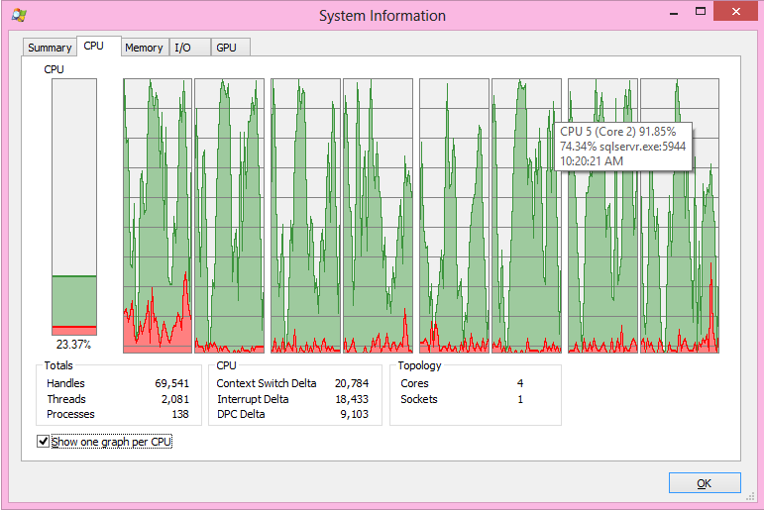
Columnstore ♥ Parallelism
In general, SQL Server will leverage all available CPUs for creating indexes or issuing readahead for satisfying queries
True for columnstore or conventional indexes
Notes:
<Do demo if time permits>

Slide 68
Demo: Leveraging Resource Governor

Slide 69
Loading New Data
Table with columnstore index can be read, but not updated
Partition switching is allowed (SQL Server 2012 & 2014)
INSERT, UPDATE, DELETE, and MERGE not allowed
Methods for loading data
Partition switching is a BEST PRACTICE for loading data in SQL Server 2012 & 2014
Disable, update, rebuild
UNION ALL between large table with columnstore index and smaller updateable table
69

Slide 70
Loading New Data (2012): Trickle Loading
Means by which to write data to SQL Server 2012
Simple variation on classic partitioning
Large historical fact table with (read-only) columnstore index
Smaller table with contemporaneous data
Analogous to partition staging table
Same schema as historical table, except no columnstore index
New data is loaded in real-time in
Query via UNION ALL
Columnstore index is created on staging table during maintenance window, then switched in
New staging table created to host new data
70

Slide 71
Insert & Updating Data
Bulk insert
Creates row groups of 1Million rows, last row group is probably not full
But if <100K rows, will be left in Row Store
Insert/Update
Collects rows in Row Store
Tuple Mover
When Row Store reaches 1Million rows, convert to a Columnstore Row Group
Runs every 5 minutes by default
Started explicitly by ALTER INDEX <name> ON <table> REORGANIZE

Slide 72
A Note on BULK INSERT: Batch Sizes
Threshold for Tuple Mover is now 100K rows
Less than full Columnstore Row Groups created by bulk insert will not be consolidated
Batches of 90K row inserts: You eventually get large Segments and are happy
Batches of 120K row inserts: You get lots of 120K Segments, and performance will not as optimal as it could be
Index rebuild will fix this by de-fragging the index, but that is resource intensive

Slide 73
Batch Size Case Study
Problem: Query Perf Degrading
Formerly minutes, worsening to 67 minutes
Scenario
1000 row inserts
4,056 "OPEN" Row Groups
Join to Hekaton table
Remedy
REBUILD Columnstore Index
Leverage 100,000 row inserts
Outcome
522 Row Groups
23sec (x174!)
No loss of concurrency
Recommendation
Leverage partitioning, result in fewer, larger Row Groups

Slide 74
Demo: Table Partitioning

Slide 75
Agenda
Introduction & Preamble
SQL Server 2012 & 2014: New! Improved! Features
Columnstore Indexes
Overview
Architecture
SQL Server 2012 vs. 2014
Implementation
Scenarios
Best Practices
More Info

Slide 76
Best Practices
Create CS indexes on “large” fact tables
Leverage “star joins”
Joins on integer keys
Include all columns of eligible datatypes
Leverage Parallelism
Provide sufficient memory
Use in conjunction with partitioned tables

Slide 77
Query Optimization
SQL Server 2012
We had a list of “gotchas” to watch out for, and workarounds
SQL Server 2014
Significant improvements to Optimizer
Good design practices for dimensional models
Star schema
Columnstores on Fact tables
Integer surrogate keys for joins to Dimension tables
The power of the platform
You just write queries!
Logically no difference between Clustered Columnstores and regular tables

Slide 78
Key Learnings
Some specific considerations in 2012 :
Read-only—for now (see references for Trickle Loading implementation)
Filtering optimizations in the storage engine are limited to numeric data types
Using OR statements in predicates results in less efficient plan vs. what is generated for row based indexes
Some OUTER JOINs
Large number of joins results in inability to use batch mode processing
Joining on string data types does not push bitmap filtering down into the storage engine
Optimizer may not optimize UNION ALL
Data type support is extensive but incomplete
AS NOTED: Significant improvements are implemented in SQL Server 2014

Slide 79
Key Learnings (cont.)
Query performance of columnstore indexes is good, even great—once you have the “right” plan & can leverage batch mode
Able to meet/beat competitors in terms of performance; however query rewrite and schema changes may be required
To get full parallelism of column store index builds may require significant memory grants. This can be problematic on wide or string heavy tables.
Parallelism on index build is not supported if table has < 1 million rows.
(Because it’s superfluous)
AlwaysOn availability groups work well for many DW workloads
Able to keep up with expected bulk load rates and columnstore index builds
Observed some upper limits on the “bytes per second” to the replica in the 40MB/s*. This caused the replica to fall behind for regular index build scenarios and more intensive loads.
*Under review with development team

Slide 80
Agenda
Introduction & Preamble
SQL Server 2012 & 2014: New! Improved! Features
Columnstore Indexes
Overview
Architecture
SQL Server 2012 vs. 2014
Implementation
Scenarios
Best Practices
More Info

Slide 81
Columnstore Indexes: More Info
The following is a must-read:
SQL Server Columnstore Index FAQ
Eric Hanson, Susan Price, etc.
http://social.technet.microsoft.com/wiki/contents/articles/3540.sql-server-columnstore-index-faq-en-us.aspx
Microsoft Internal:
SQL 14 What's new with AlwaysOn and Column Store Indexes
Other references:
My blog http://blogs.msdn.com/jimmymay
Niko Neugebauer’s blog
http://www.nikoport.com
Columnstore Indexes
http://msdn.microsoft.com/en-us/library/gg492088(SQL.110).aspx
SQL Server Columnstore Performance Tuning
http://social.technet.microsoft.com/wiki/contents/articles/4995.sql-server-columnstore-performance-tuning.aspx
Trickle Loading with Columnstore Indexes
http://social.technet.microsoft.com/wiki/contents/articles/trickle-loading-with-columnstore-indexes.aspx
How do Column Stores Work?
Thomas Kejser
http://blog.kejser.org/2012/07/04/how-do-column-stores-work
This is Columnstore – Part 1
Gavin Payne, MCM
http://gavinpayneuk.com/2012/07/22/this-is-columnstore-part-1

Slide 82
Thank You!

